Slide 1
Java Exception Handling Chapter 12 Introduction to Java Programming – Comprehensive Version Y. Daniel Liang

Slide 2
Introduction
Exception handling enables a program to deal with exceptional situations and continue its normal execution.
Runtime errors occur while a program is running if the JVM (JRE) detects an operation that is impossible to carry out. For example:
If you access an array using an index that is out of bounds, you will get a runtime error with an ArrayIndexOutOfBoundsException.
If you enter a double value when your program expects an integer, you will get a runtime error with an InputMismatchException.
In Java, runtime errors are thrown as exceptions.
An exception is an object that represents an error or a condition that prevents execution from proceeding normally.
If the exception is not handled, the program will terminate abnormally

Slide 3
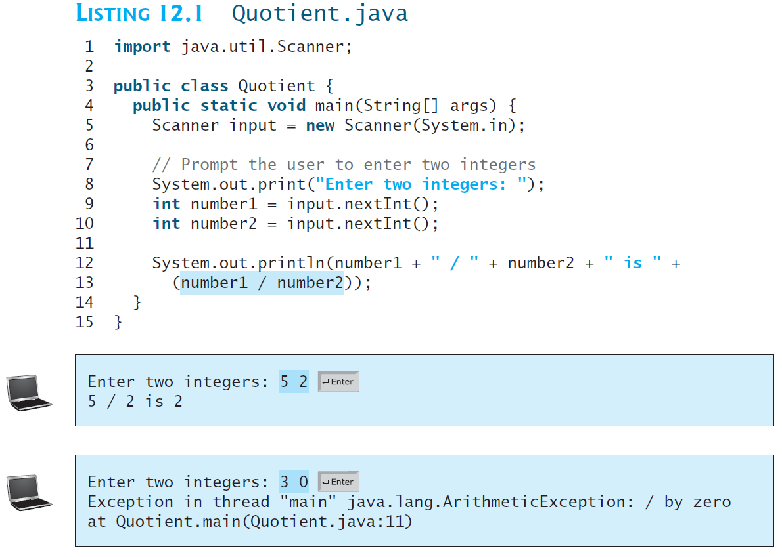
Exception Handling Overview
Exceptions are thrown from a method. The caller of the method can catch and handle the exception.
Note that a floating-point number divided by 0 does not raise an exception

Slide 4
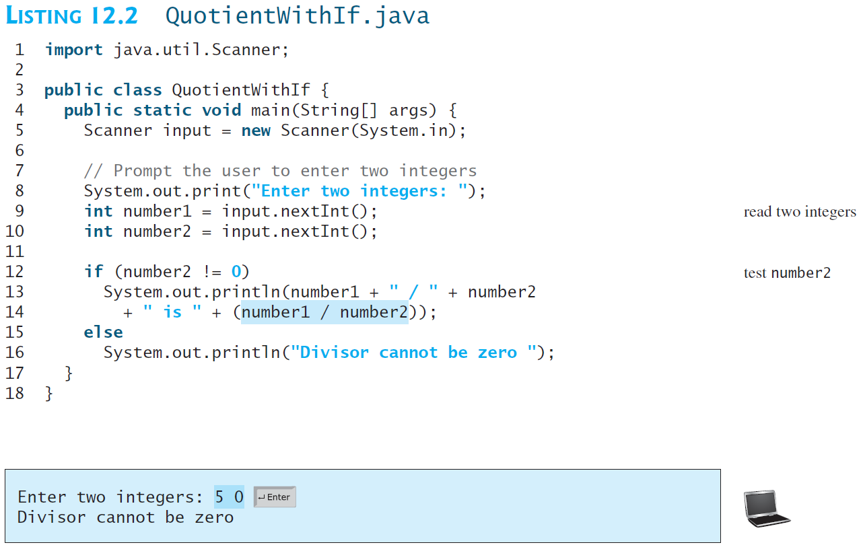
Exception Handling Overview
A simple way to fix this error is to add an if statement to test the second number, as shown in Listing 12.2.

Slide 5
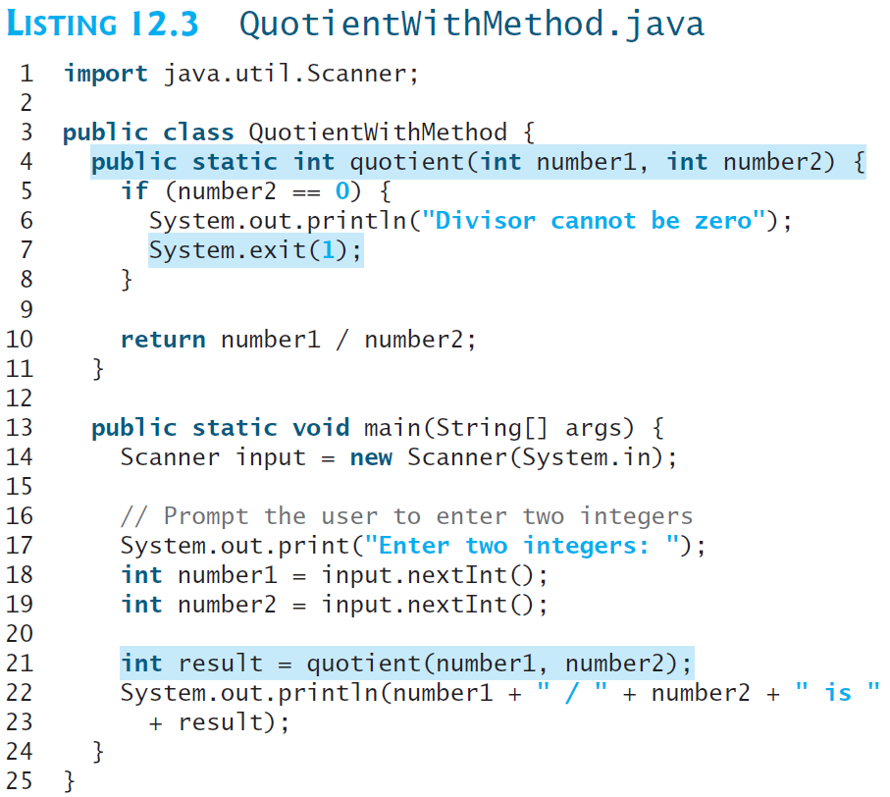
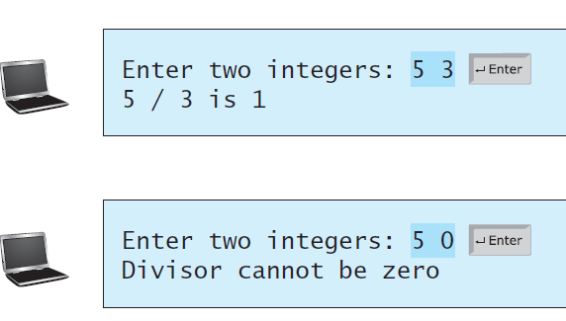
Exception Handling Overview
Before introducing exception handling, let us rewrite Listing 12.2 to compute a quotient using a method, as shown in Listing 12.3.
Note that this approach is problematic. You should not let the method terminate the program—the caller should decide whether to terminate the program.
How can a method notify its caller an exception has occurred?

Slide 6
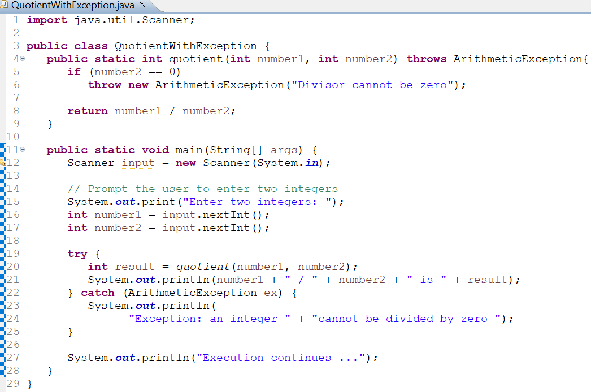
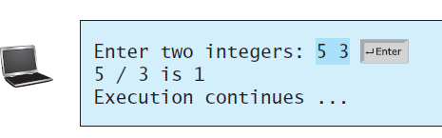

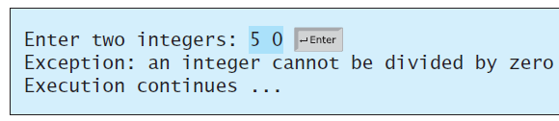
Exception Handling Overview
Java enables a method to throw an exception that can be caught and handled by the caller.

Slide 7
Exception Handling Overview
The value thrown in the previous code, new ArithmeticException("Divisor cannot be zero") is called an exception.
The execution of a throw statement is called throwing an exception.
The exception is an object created from an exception class.
In this case, the exception class is java.lang.ArithmeticException.
When an exception is thrown, the normal execution flow is interrupted.
As the name suggests, to “throw an exception” is to pass the exception object from one place to another.

Slide 8
Exception Handling Overview
The statement for invoking the method is contained in a try block and a catch block.
The try block (lines 19–23) contains the code that is executed in normal circumstances.
The exception is caught by the catch block.
The code in the catch block is executed to handle the exception.
Afterward, the statement (line 29) after the catch block is executed.
The identifier ex in the catch–block header catch (ArithmeticException ex)acts very much like a parameter in a method.
Thus, this parameter is referred to as a catch–block parameter.
The type (e.g., ArithmeticException) preceding ex specifies what kind of exception the catch block can catch.
Once the exception is caught, you can access the thrown object from this parameter in the body of a catch block.

Slide 9
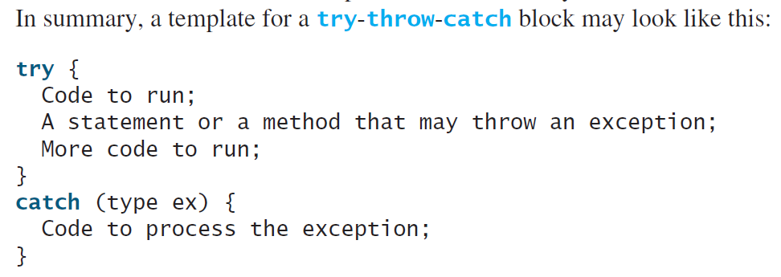
Exception Handling Overview
An exception may be thrown directly by using a throw statement in a try block, or by invoking a method that may throw an exception.
The advantage of using exception handling: it enables a method to throw an exception to its caller, enabling the caller to handle the exception.
Without this capability, the called method itself must handle the exception or terminate the program.

Slide 10
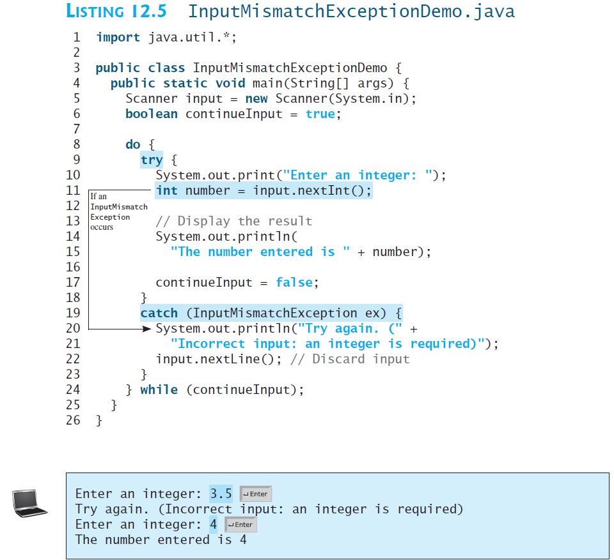
Exception Handling Overview
Often the called method does not know what to do in case of error.
This is typically the case for the library methods. The library method can detect the error, but only the caller knows what needs to be done when an error occurs.
The key benefit of exception handling is separating the detection of an error (done in a called method) from the handling of an error (done in the calling method).
In Listing 12.5, the statement input.nextLine() in line 22 discards the current input line so that the user can enter a new line of input.

Slide 11
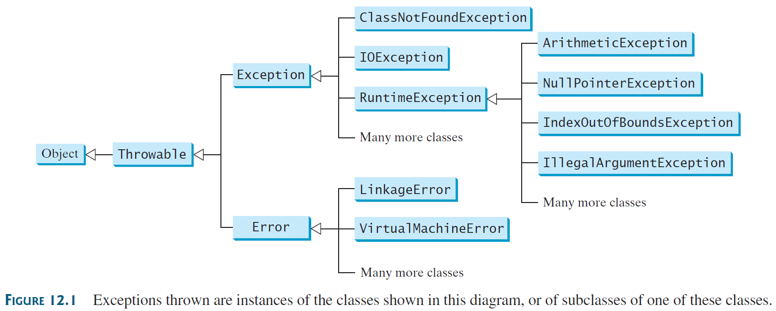
Exception Types
Exceptions are objects, and objects are defined using classes. The root class for exceptions is java.lang.Throwable.
All Java exception classes inherit directly or indirectly from Throwable.
You can create your own exception classes by extending Exception or a subclass of Exception.
There are many predefined exception classes in the Java API.

Slide 12
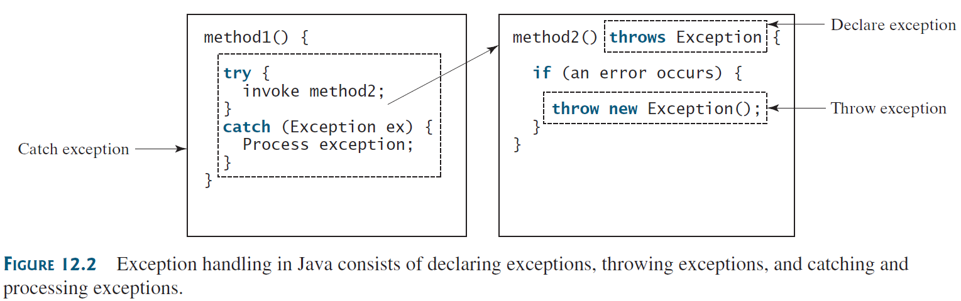
More on Exception Handling
A handler for an exception is found by propagating the exception backward through a chain of method calls, starting from the current method.
Java’s exception-handling model is based on three operations: declaring an exception, throwing an exception, and catching an exception, as shown in Figure 12.2.

Slide 13
More on Exception Handling
Declaring Exceptions
To declare an exception in a method, use the throws keyword in the method header
If the method might throw multiple exceptions, add a list of the exceptions, separated by commas, after throws:
Note: If a method does not declare exceptions in the superclass, you cannot override it to declare exceptions in the subclass.

Slide 14
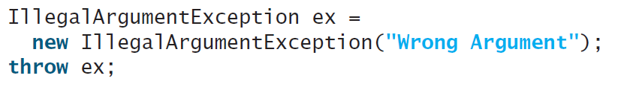
More on Exception Handling
Throwing Exceptions
A program that detects an error can create an instance of an appropriate exception type and throw it.
For example, suppose a method in a program detects that the argument passed to it violates the method contract (e.g., the argument must be nonnegative, but a negative argument is passed); then the method can create an instance of IllegalArgumentException and throw it:
Or you can use a simplified version:
Note: In general, each exception class in the Java API has at least two constructors: a no-arg constructor and a constructor with a String argument that describes the exception. This argument is called the exception message, which can be obtained using getMessage().
Note: The keyword to declare an exception is throws, and the keyword to throw an exception is throw.

Slide 15
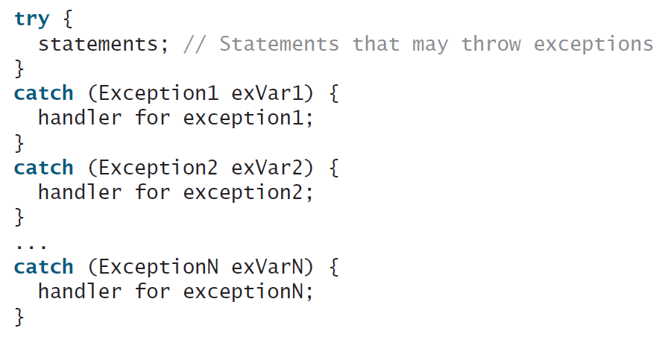
More on Exception Handling
Catching Exceptions
When an exception is thrown, it can be caught and handled in a try-catch block, as follows:
If no exceptions arise during the execution of the try block, the catch blocks are skipped.
If one of the statements inside the try block throws an exception, Java skips the remaining statements in the try block and starts the process of finding the code to handle the exception.
The code that handles the exception is called the exception handler; it is found by propagating the exception backward through a chain of method calls, starting from the current method.
Each catch block is examined in turn, from first to last, to see whether the type of the exception object is an instance of the exception class in the catch block.
If so, the exception object is assigned to the variable declared, and the code in the catch block is executed.

Slide 16
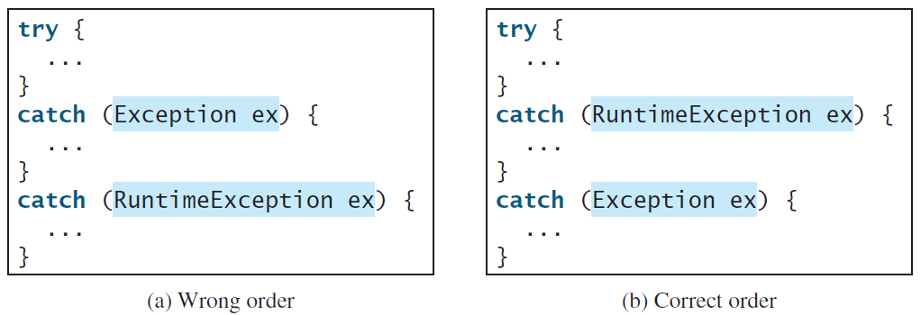
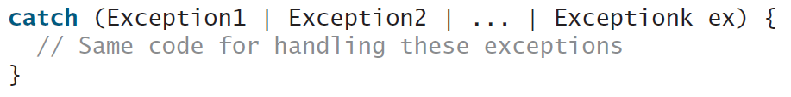
More on Exception Handling
Catching Exceptions
If no handler is found, Java exits this method, passes the exception to the method that invoked the method, and continues the same process to find a handler.
If no handler is found in the chain of methods being invoked, the program terminates and prints an error message on the console.
The process of finding a handler is called catching an exception.
Note: The order in which exceptions are specified in catch blocks is important. A compile error will result if a catch block for a superclass type appears before a catch block for a subclass type.
Note: You can use the multi-catch feature (introduced from JDK 7) to simplify coding for the different exceptions with the same handling code. The syntax is:

Slide 17
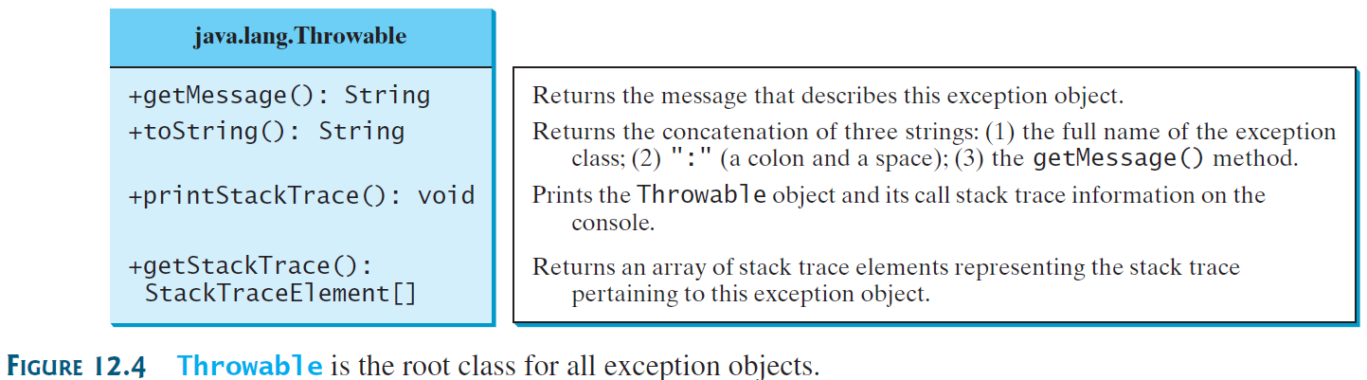
More on Exception Handling
Getting Information from Exceptions
An exception object contains valuable information about the exception.
The following instance methods in the java.lang.Throwable class can be used to get information regarding the exception:
Homework: Compile and run the code in LISTING 12.6 TestException.java (textbook page 462)

Slide 18
More on Exception Handling
Example: Declaring, Throwing, and Catching Exceptions
The code in the next slide demonstrates declaring, throwing, and catching exceptions by modifying the setRadius() method in the Circle class in Listing 9.8 (CircleWithPrivateDataFields.java).
The new setRadius() method throws an exception if the radius is negative.

Slide 19
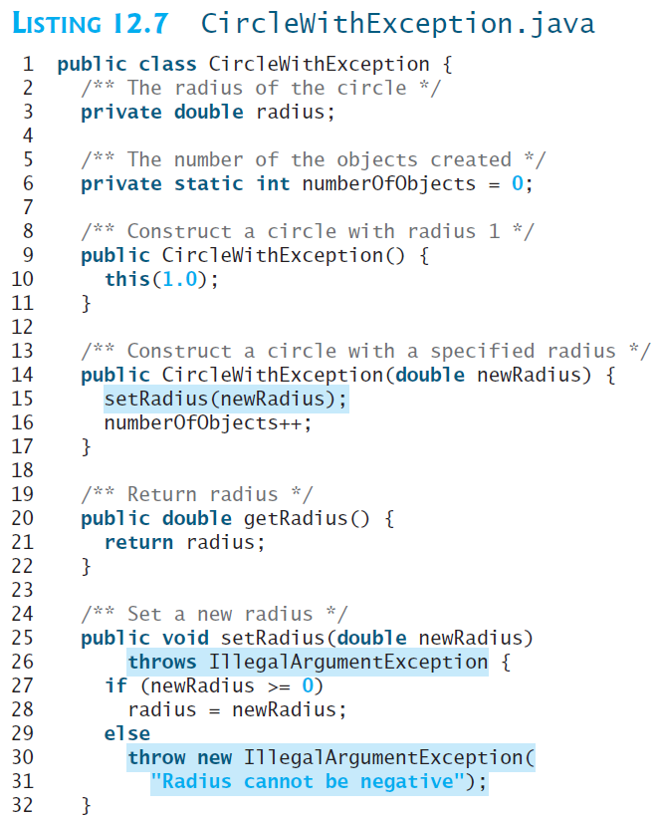
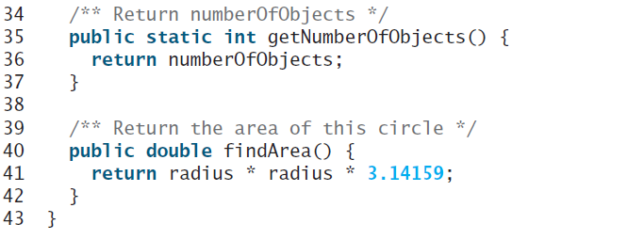
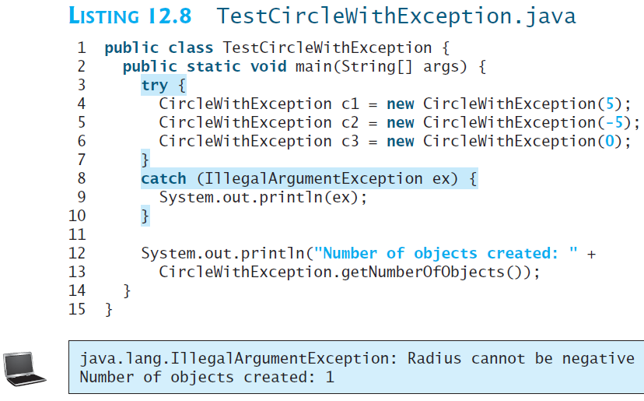
More on Exception Handling

Slide 20
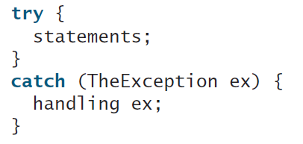
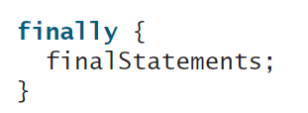
More on Exception Handling
The finally Clause
Occasionally, you may want some code to be executed regardless of whether an exception occurs or is caught.
The code in the finally block is executed under all circumstances, regardless of whether an exception occurs in the try block or is caught. Consider three possible cases:
If no exception arises in the try block, finalStatements is executed, and the next statement after the try statement is executed.
If a statement causes an exception in the try block that is caught in a catch block, the rest of the statements in the try block are skipped, the catch block is executed, and the finally clause is executed. The next statement after the try statement is executed.
If one of the statements causes an exception that is not caught in any catch block, the other statements in the try block are skipped, the finally clause is executed, and the exception is passed to the caller of this method.
The finally block executes even if there is a return statement prior to reaching the finally block.
Note: The catch block may be omitted when the finally clause is used.

Slide 21
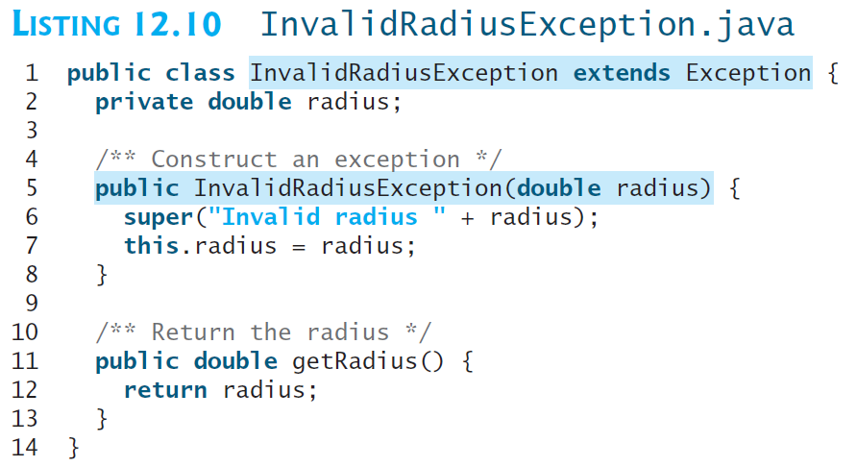
Defining Custom Exception Classes
Java provides quite a few exception classes. Use them whenever possible instead of defining your own exception classes.
However, if you run into a problem that cannot be adequately described by the predefined exception classes, you can create your own exception class, derived from Exception or from a subclass of Exception, such as IOException.
Example: In Listing 12.7, CircleWithException.java, the setRadius method throws an exception if the radius is negative. Suppose you wish to pass the radius to the handler. In that case, you can define a custom exception class, as shown in the next slide (Listing 12.10).

Slide 22
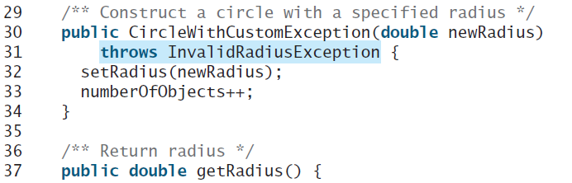
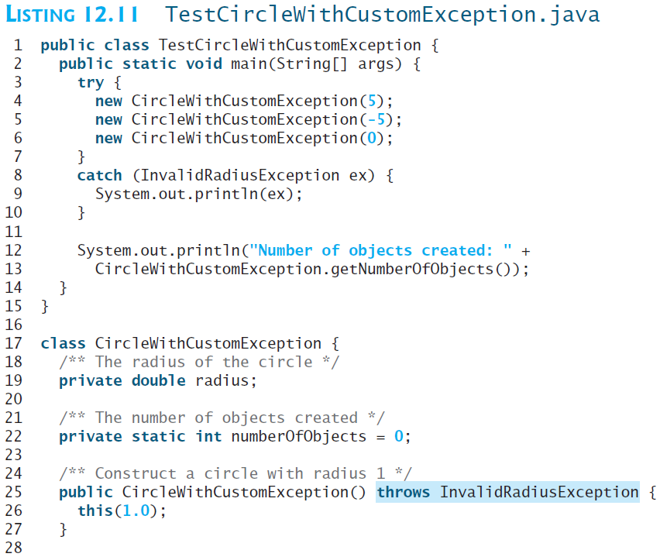
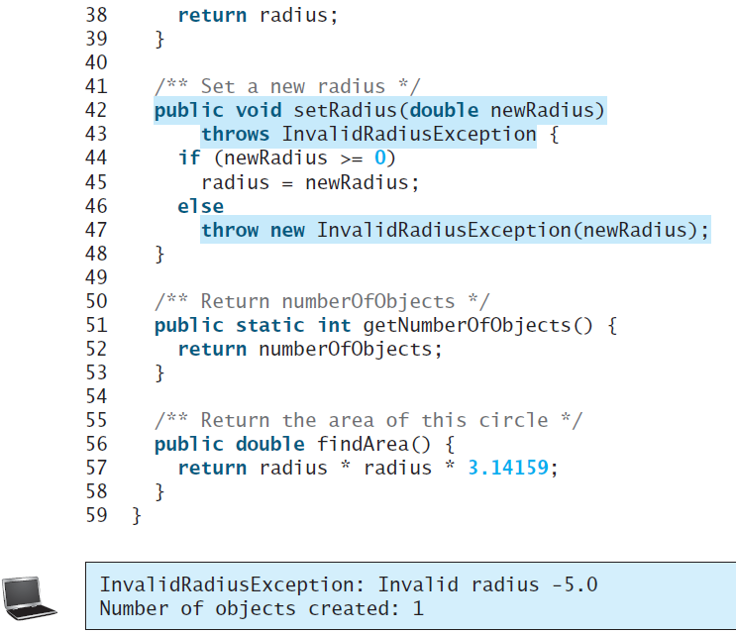
Defining Custom Exception Classes

